Slide 1


Slide 2
Chapter 8
SQL-99: Schema Definition, Basic Constraints, and Queries

Slide 3
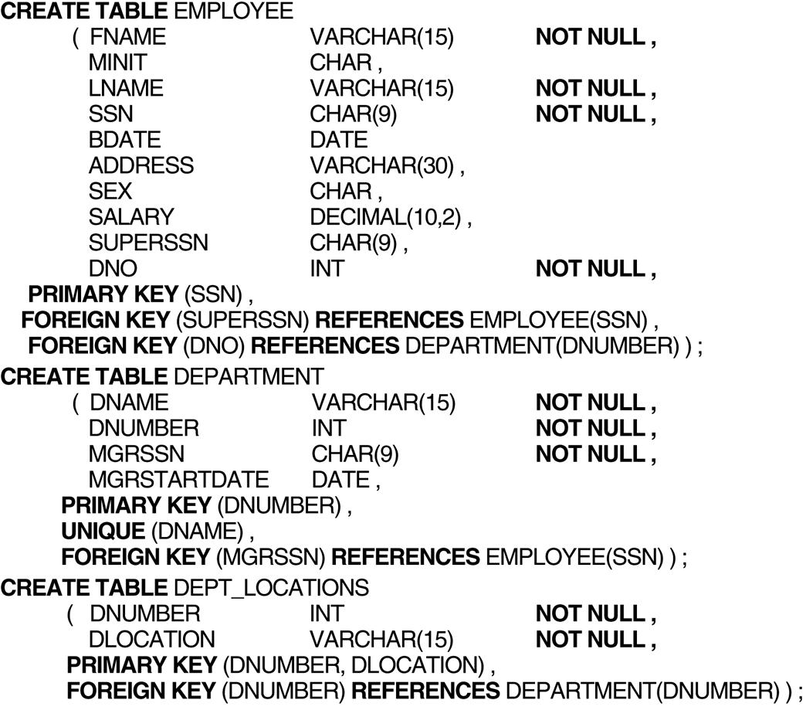
FIGURE 8.1
SQL CREATE TABLE data definition statements for defining the COMPANY schema from Figure 5.7.

Slide 4
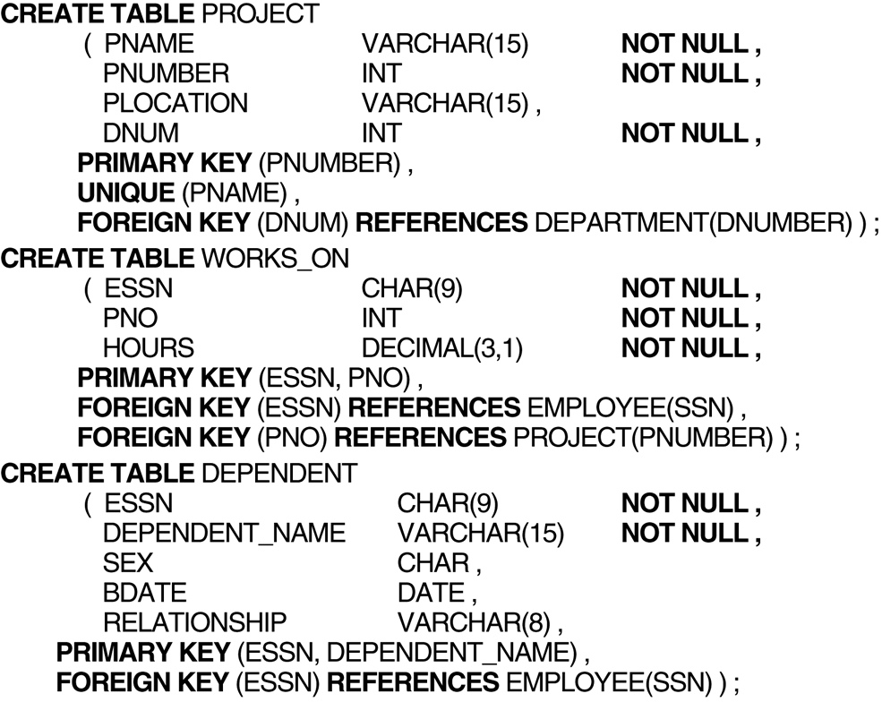
FIGURE 8.1 (continued)
SQL CREATE TABLE data definition statements for defining the COMPANY schema from Figure 5.7.

Slide 5
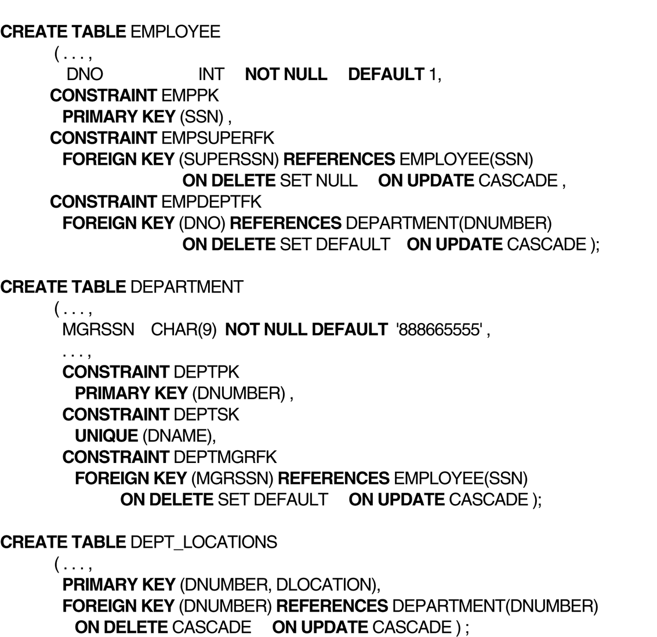
FIGURE 8.1
(continued)
SQL CREATE TABLE data definition statements for defining the COMPANY schema from Figure 5.7.

Slide 6
FIGURE 8.2
Example illustrating how default attribute values and referential triggered actions are specified in SQL.

Slide 7
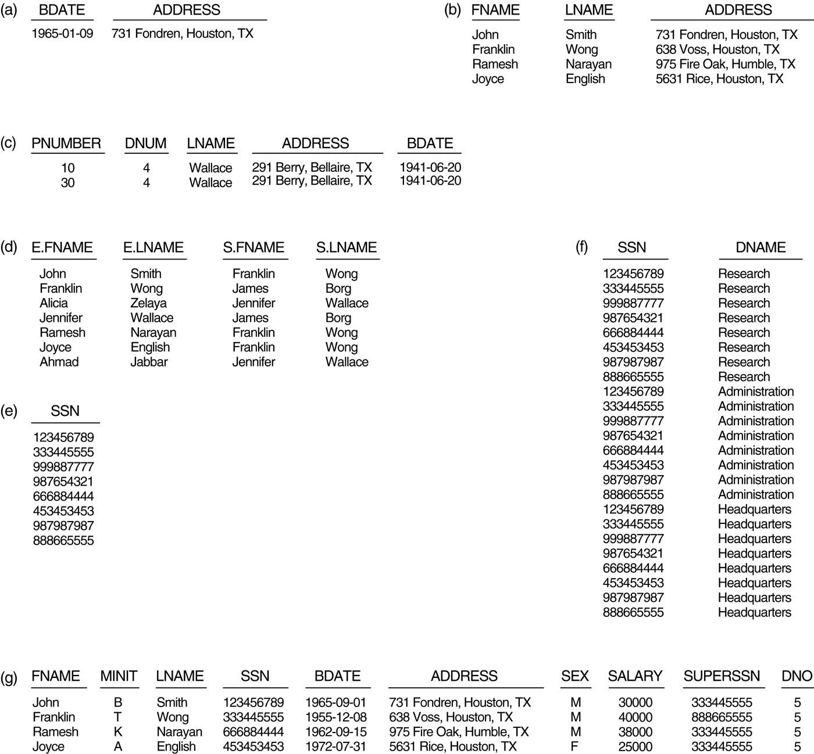
FIGURE 8.3
Results of SQL queries when applied to the COMPANY database state shown in Figure 5.6.
(a) Q0. (b) Q1. (c) Q2. (d) Q8. (e) Q9. (f) Q10. (g) Q1C.

Slide 8
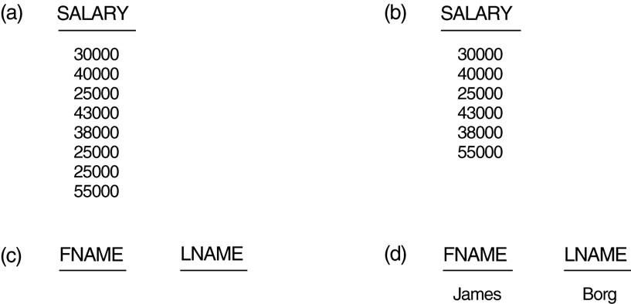
FIGURE 8.4
Results of additional SQL queries when applied to the COMPANY database state shown in Figure 5.6. (a) Q11. (b) Q11A. (c) Q16. (d) Q18.

Slide 9
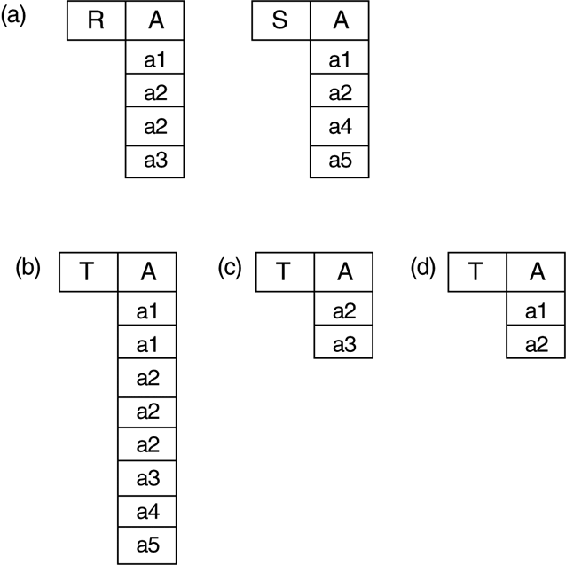
FIGURE 8.5
The results of SQL multiset operations. (a) Two tables, R(A) and S(A). (b) R(A) UNION ALL S(A). (c) R(A) EXCEPT ALL S(A). (d) R(A) INTERSECT ALL S(A).

Slide 10
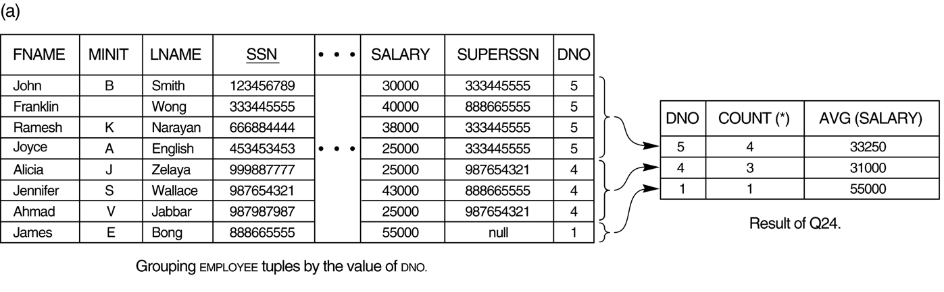
FIGURE 8.6
Results of GROUP BY and HAVING. (a) Q24. (b) Q26.

Slide 11
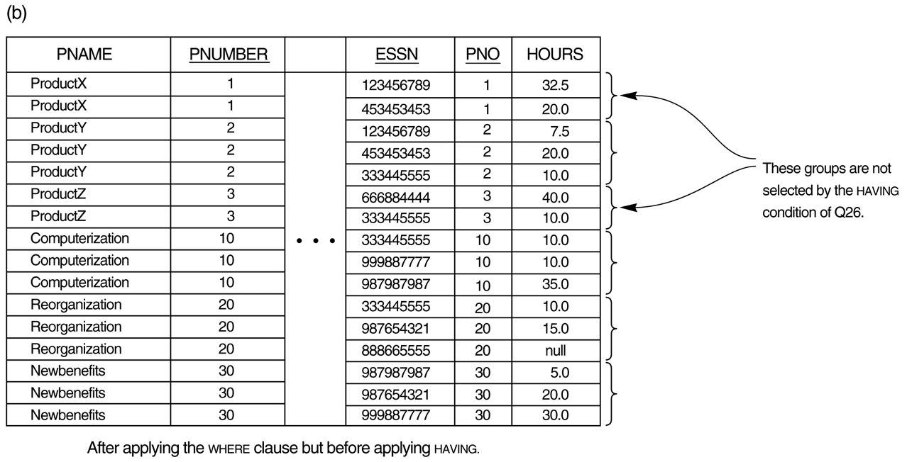
FIGURE 8.6 (continued)
Results of GROUP BY and HAVING. (b) Q26.

Slide 12
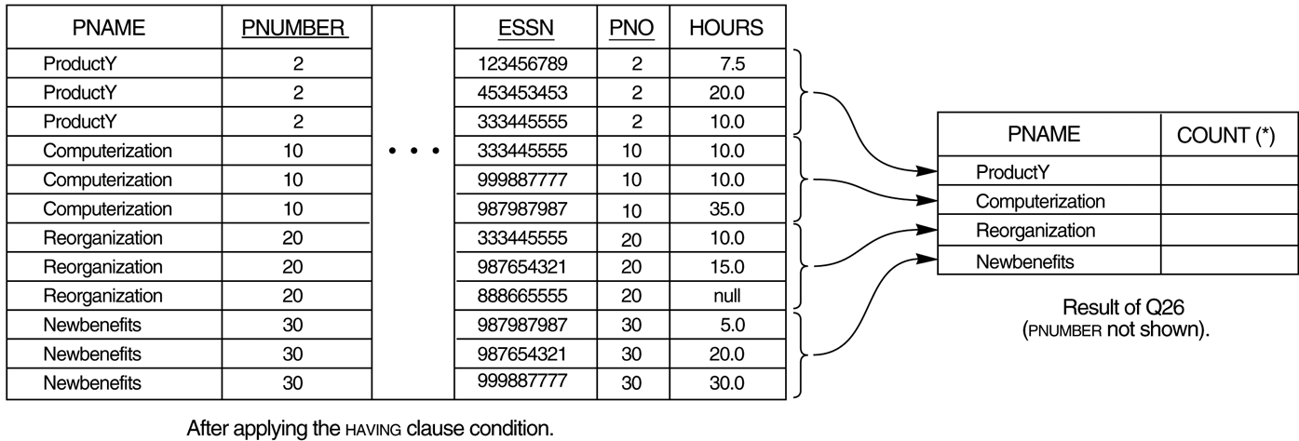
FIGURE 8.6 (continued)
Results of GROUP BY and HAVING. (b) Q26.

